Slide 1
WrenchIt
Sprint 6 Implementation
Group 9
By: Henrique Custodio, Hossein Khanzadeh, Tyson Ward-Dicks, Frederich Tan, and Hamzah Hafez

Slide 2
Delivered vs Planned
⏭ Delivered
⏭ Deferred
Modern Frontend
App Containerization
Full Auth UX
React based with modern styling and flow
Use of Docker to containerize services
Keycloak end-to-end user flows
Verification System
Credentials checking system
Google API Integration
Data Model
Basic integration and display of stores
Schema support for user profile, shop to owner mapping
Receipt upload lifecycle
Full Feature completion

Slide 3

Sprint 6: Milestones
Backend
Controllers and core logic created
Frontend
Pages tied to backend endpoints
Overall
Application can now be stood up!

Slide 4
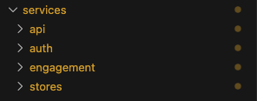
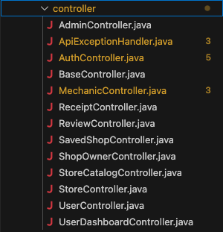
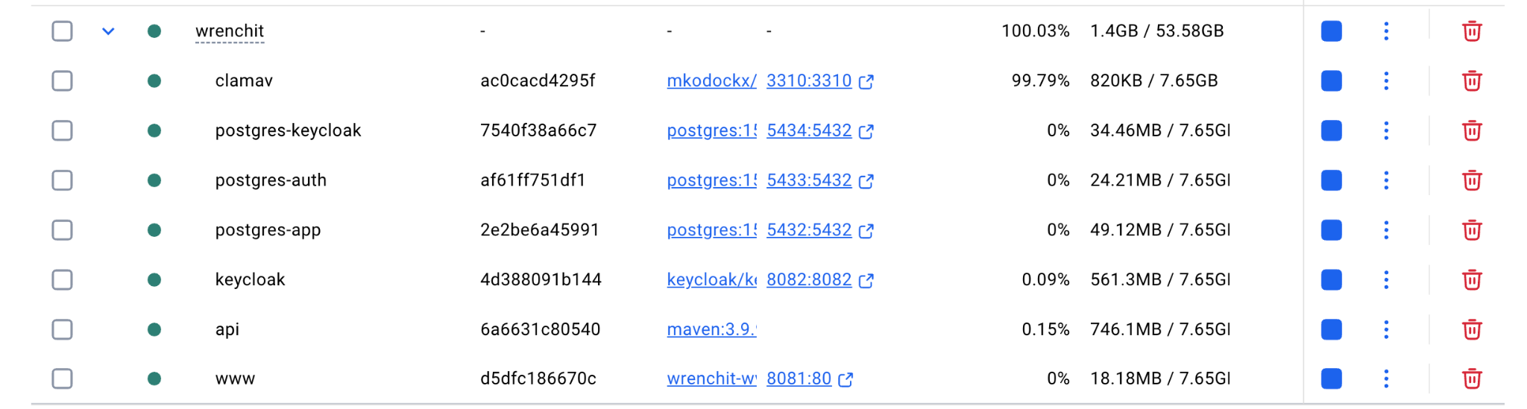
Project Structure & Architecture
Use of several Java Modules rather than monolithic project.
Separation of responsibility via services.
Decomposition into modular classes.

Slide 5


Infrastructure Plan
Docker Based
Consistent Runtime
Containerization of application
Segregated services.
Easy deployment strategy
Verified service dependency order
API waits for database readiness
Same environment for every deployment, regardless of infrastructure provider.
Small Footprint
A single cloud VM for deployment.

Slide 6
WrenchIT Frontend — Overview
Docker-friendly React UI fully integrated with the backend API.
What I built
Tech stack
• Full UI page set (Home, Search, Shop Profile, Compare, Dashboards, Forms)
• Reusable component system (cards, badges, stats, reviews)
• Routing + shared Layout (Navbar/Footer)
• API wiring via a centralized client layer
• React + Vite
• Bootstrap (structure) + custom theme (pixel accuracy)
• Docker demo: Caddy serves dist + proxies /api → Spring Boot
• Git workflow: feature branch + PR, merge-safe changes
Architecture
React UI (Vite)
Caddy (www)
Spring Boot API
Pages + components
/api client layer
Serves dist
Proxies /api/*
Stores + reviews
Auth (toggle)
COMP3059 Capstone — WrenchIT
Frontend (Hossein)
Notes:
[Sources]
- No external visuals used. Slide content reflects project implementation choices.
[/Sources]

Slide 7
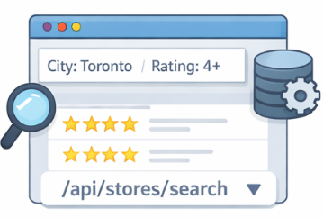
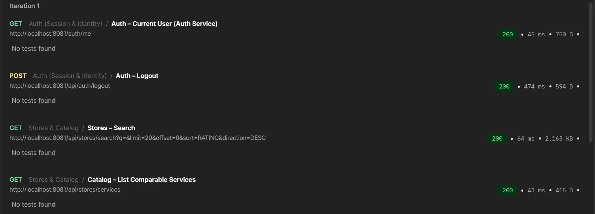
API-Driven UI
The frontend sends search and filter requests to the backend and dynamically renders the returned results.
No local dataset filtering
URL reflects filters and pagination
Server controls sorting and search logic
This ensures consistency between the UI and backend data.

Slide 8

Role-Based Structure
The frontend separates features by user role while maintaining a shared layout and navigation system.
User
Mechanic
Shop Owner
Admin
Each role operates in its own module and is ready for secure access control via Keycloak.

Slide 9

Database Architecture & Migration Strategy
PostgreSQL (Dockerized Environment)
Flyway Versioned Migrations (v1 → v27)
Schema-First Design Approach
Idempotent Seed Data for Demo Stability
Indexed Query Optimization
View-Based API Abstraction

Slide 10
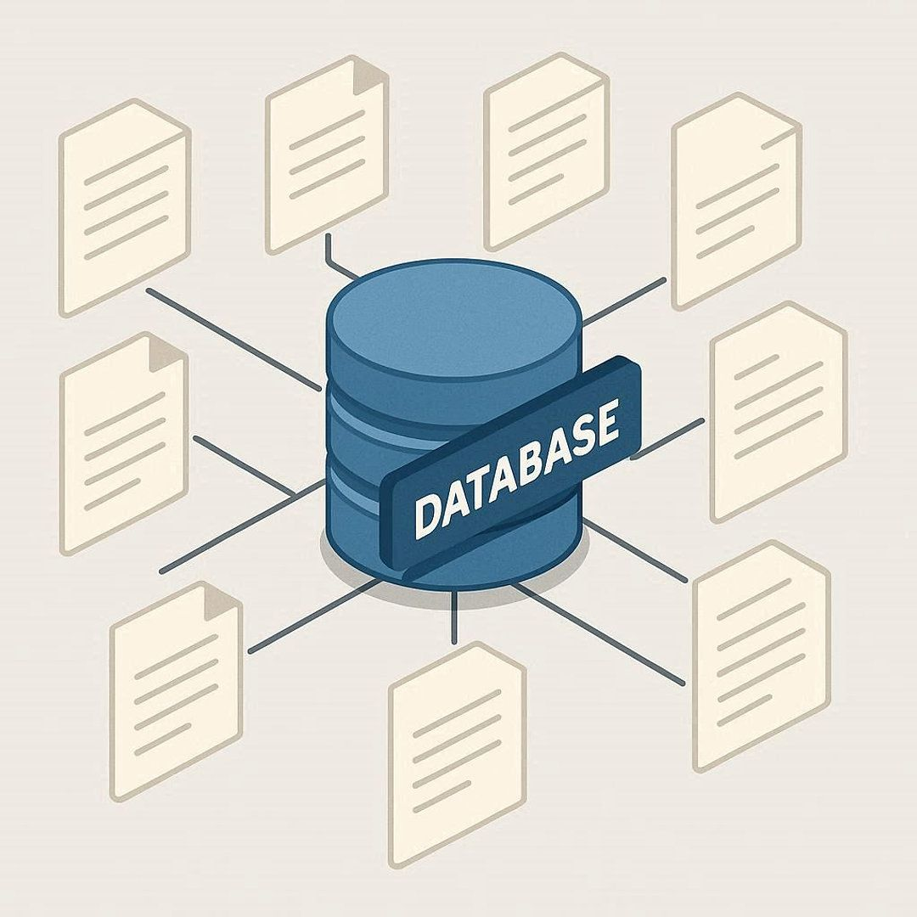
Review Lifecycle – Database Layer
Store_review Table (Normalized design)
Rating Constraints (1-5 enforced in DB)
Unique (store_id, user_id) Review Protection
Indexed by Store & User for Fast Retrieval
Aggregated via Database Views
v_store_rating_summary
v_store_details(Rounded Ratings)

Slide 11
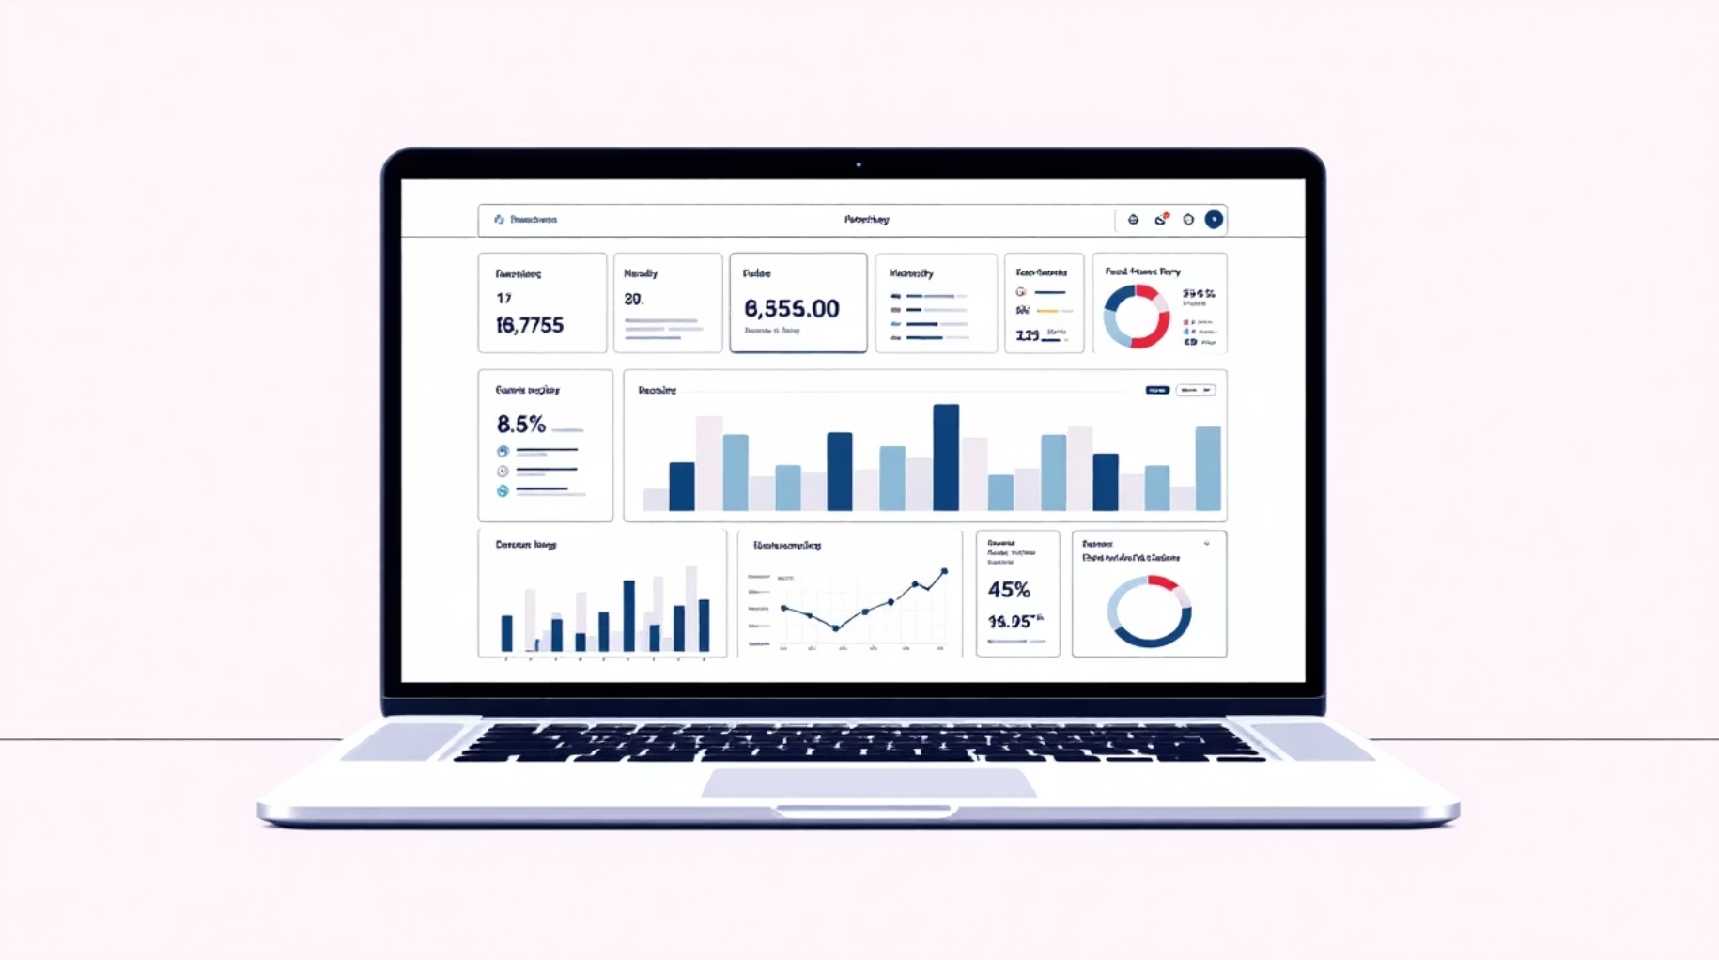
Receipt Upload & Validation Architecture
receipt_uploads (Metadata-Only Storage)
Status-Based Workflow (Upload → Review → Decision)
receipt_validations (Decision History Preserved)
Latest Decision via LATERAL Join View
Unified Query via v_receipt_details

Slide 12

Data Integrity & Defensive Design
Check Constraints for Domain validation
Foreign Key Enforcement
Unique Constraints for data safety
Indexed Foreign Keys For Performance
Status-Driven Workflow Enforcement
Server-Side Deduplication strategy

Slide 13

Backend Integration
Database → API → Frontend Contract
Views Exposed as API Data Sources
DTOs Mapped from View Layer
Status Transitions Updated Server-Side
No business logic in Frontend
Database as Source of Truth

Slide 14
Beneficiaries
Four Roles, One Shell
Users can search, compare, review, and save shops efficiently using API-driven functionality.
Different user roles are separated by route, while maintaining a unified layout, consistent navigation, and shared session context.
Mechanics manage service offerings and interact with customer-generated reviews.
Every role is structured as a separate domain module, making it ready for secure, role-based authentication through Keycloak.
Admins maintain platform integrity, enforce rules, and manage system-level controls.
Shop Owners oversee store performance, ratings, and operational workflows.

Slide 15

User Authentication and Authorization Solution
Benefits:
User authentication, registration, and authorization.
Provides secure industry standard solution.
Provides simple administration of user base .

Slide 16
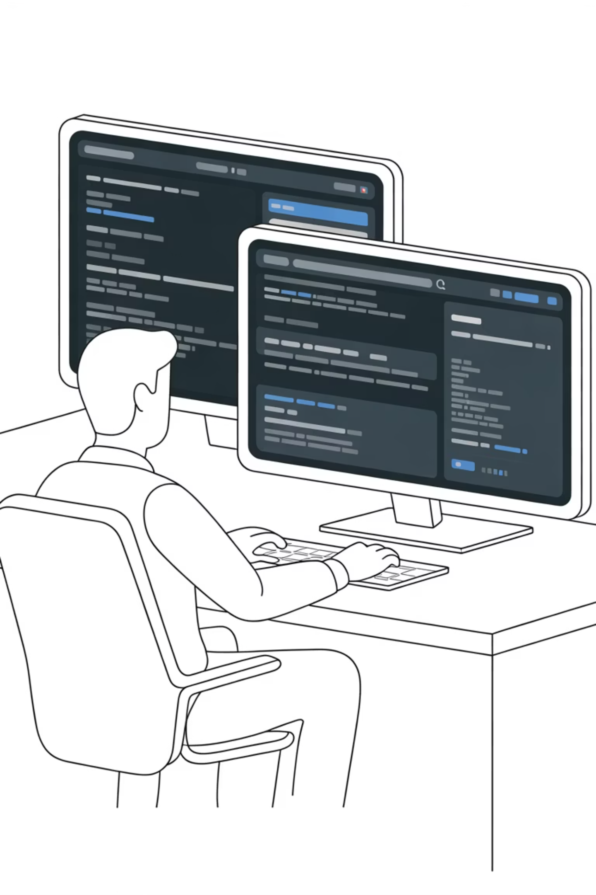
Test-Profile Isolation in Backend
How It Works
Main benefit:
Allows mvn test to run quickly and independently without interfering with the main database.
The application-test.yml file configures an in-memory H2 database and separate test settings that do not affect the main application.
Engineering Value
Isolated test profiles ensure fast, reliable, and safe backend testing without impacting real application data.

Slide 17
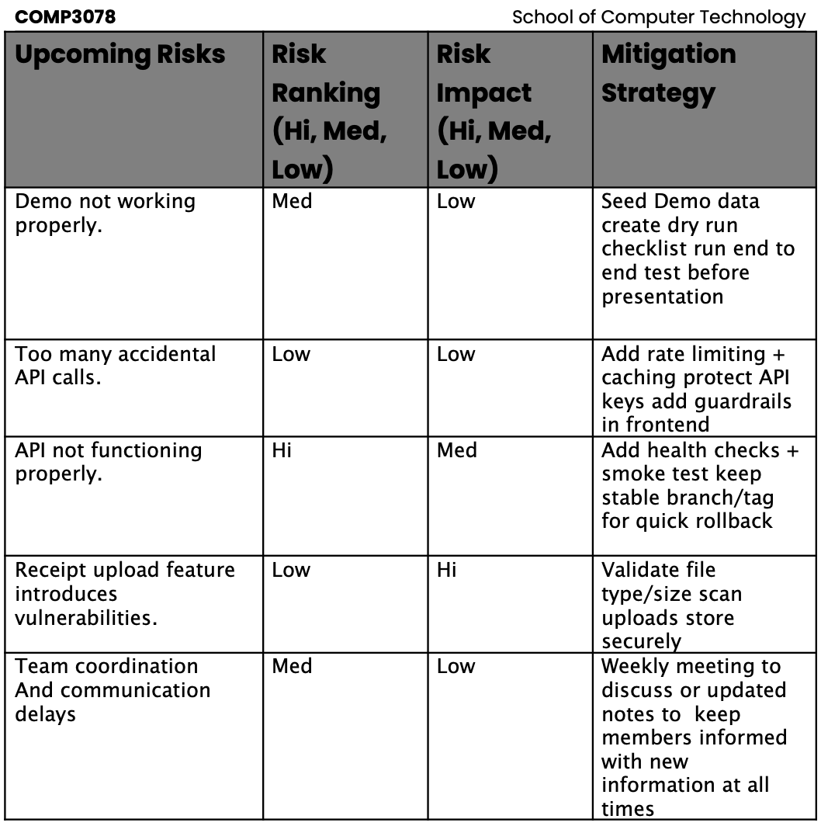
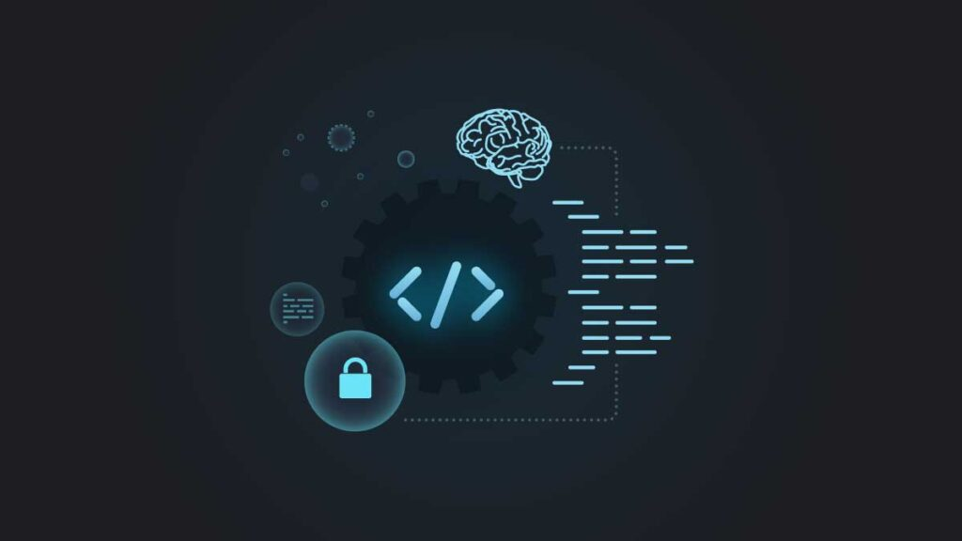
Current & Upcoming Risks

Slide 18

My Deliverables Future Implementations
Google Map View On the Search page
Added nearby search integration
Added user location flow (use my location) with radius overlay and map markers
Added safe fallback/error messaging
Fixed key bugs
etc
Show real mechanic shop pins from live data, not only seeded/demo records.
Enable backend Google Places live mode (WRENCHIT_GOOGLE_ENABLED=true) for real shop discovery.
Real production key restrictions (localhost + deployed domain) and key rotation policy.

Slide 19
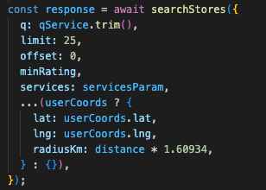
API-Backed Dynamic Search
Live results driven by GET /api/stores/search — filters reflected directly in the URL.
URL-Driven State
Clean Separation
Query params mirror filter UI — shareable links, browser nav consistency.
Frontend creates query state · Backend returns structured DTOs
Geolocation Search Integration (Planned)
Provide closest and best reviewed recommendations first · Server Driven.
Server-Side Logic
Backend owns pagination, sorting, and filtering — no frontend drift.
Pattern: Server driven filtering with client-controlled query state.

Slide 20
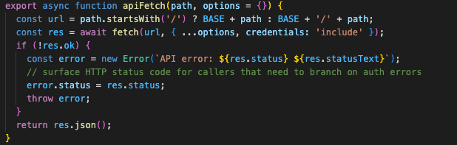



API Call Example
Saved Shops Round-Trip
Full save → list → unsave flow implemented with explicit state transition endpoints, and validation.
Save
List
Unsave
POST endpoint — explicitly adds store to user's saved list
GET endpoint — retrieves all saved stores for current user
DELETE endpoint — cleanly removes entry, no toggle ambiguity

Slide 21

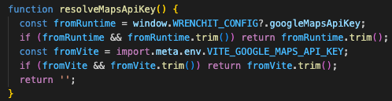
Code Snippet - Google Maps API Key
Single Config Value Enables Map
Public Repo, Key Hidden
Team-Only Key Access
Seperated Map Architecture
resolveMapsApiKey() Loads Key

Slide 22
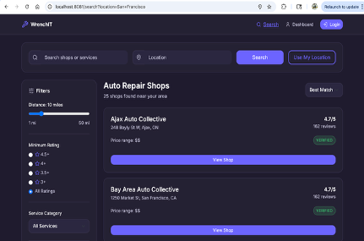
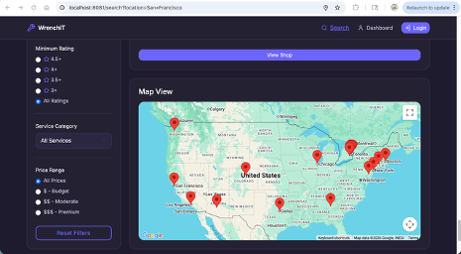
Map Demo/Search Page
Top of the Search page Bottom of the Search page

